Slide 1
Strength In People & power in the Community through Dental Collaboration Partnerships and Outreach

Slide 2
Strength In People
GPHA Dental Staff
Knowledgeable
Patients
Knowledgeable
Resources
Organizations
Skilled
Compassionate
Patient -Centered
Healthy
Access to Care
Non-profits
Corporations
Insurance Co
Churches
Foundations
Social Service
Schools
Trained – GPHA University
Assessments and Audits
360-Feedback

Slide 3
The Power of Community
GPHA
Patients
Schools
Churches
Social Service Agencies
Healthcare Facilities
Business and Industry
Foundations
Collaboration
Partnerships
Outreach

Slide 4
Schools
Child Development Centers
Woodland Academy Program - ~125 students
Head Start
Anticipatory Guidance for Parents
Universities – Student Externs
Temple
Dental Assistant Schools
Charter Schools

Slide 5
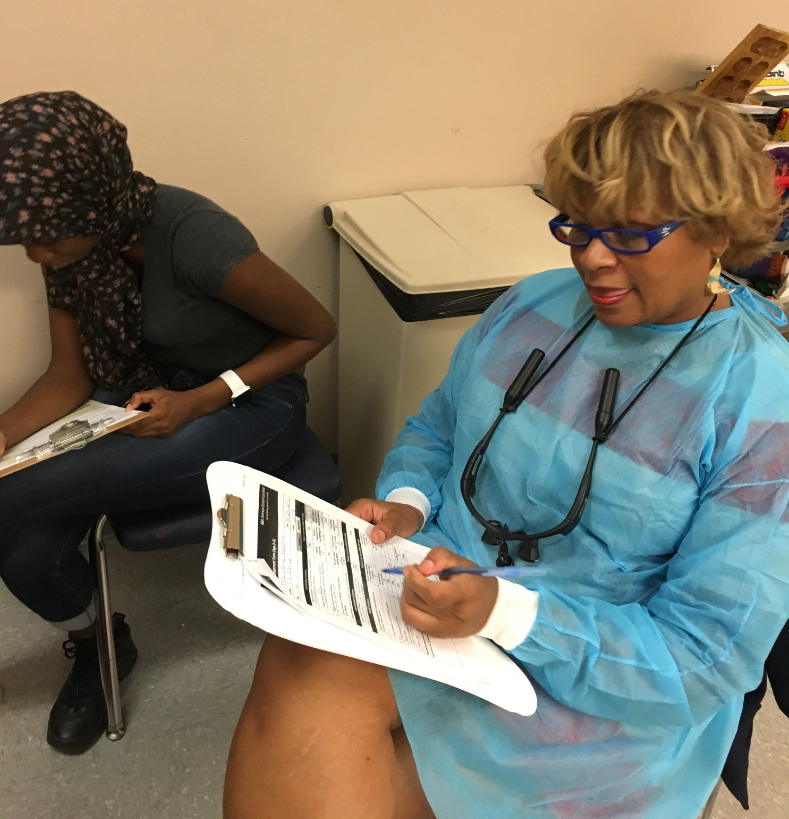
Woodland Academy

Slide 6
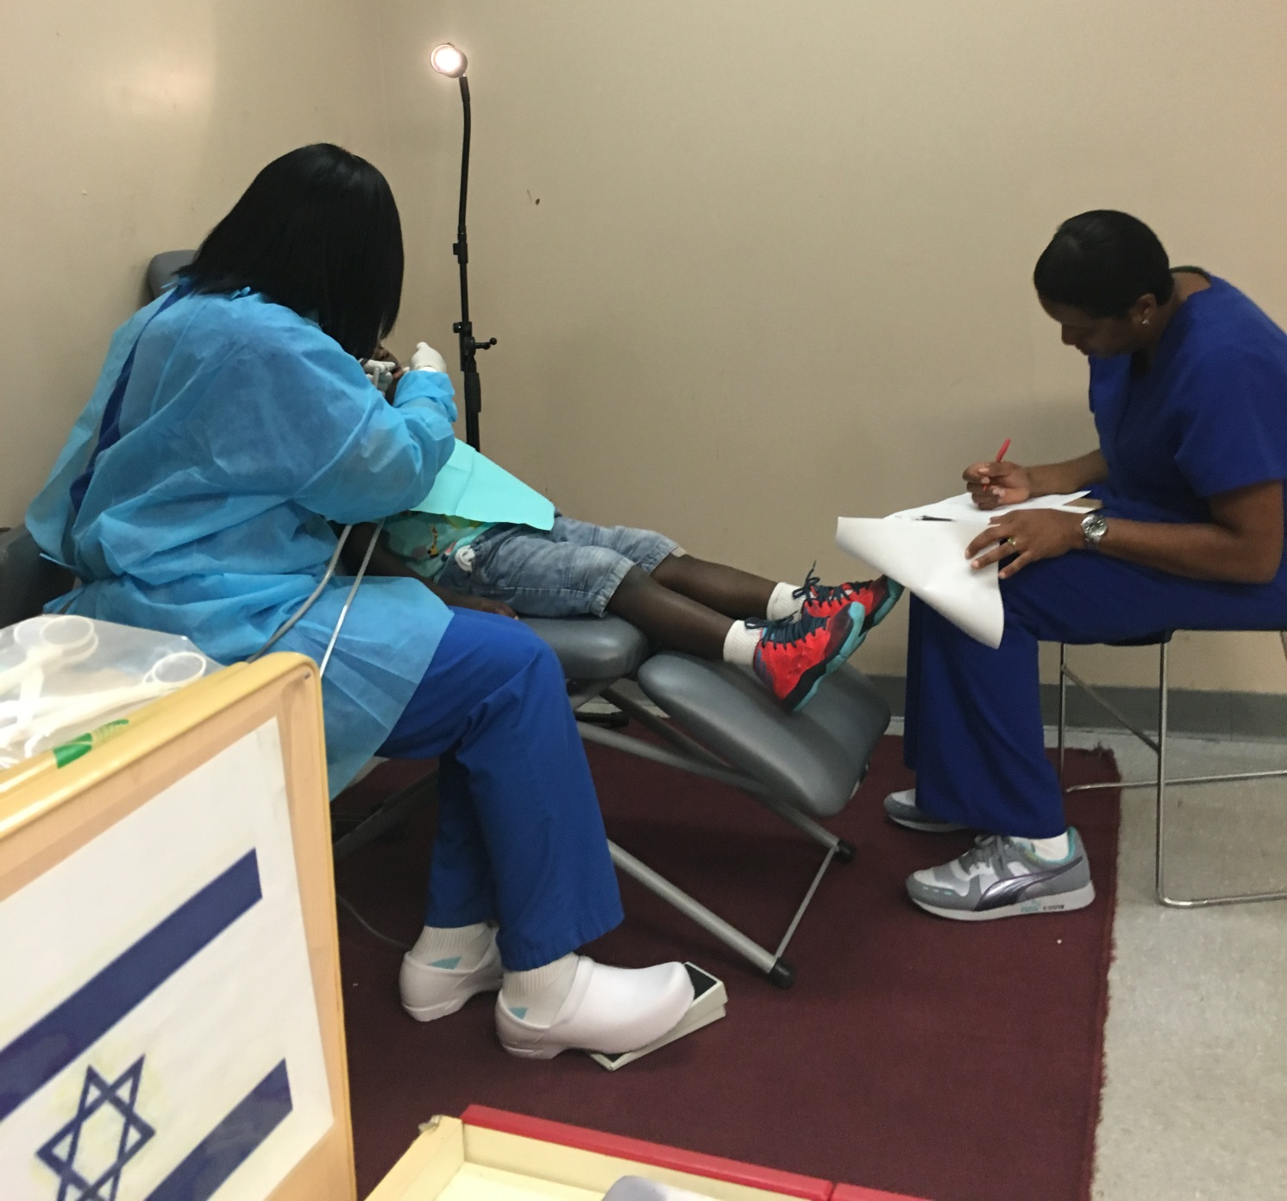
Woodland Academy

Slide 7
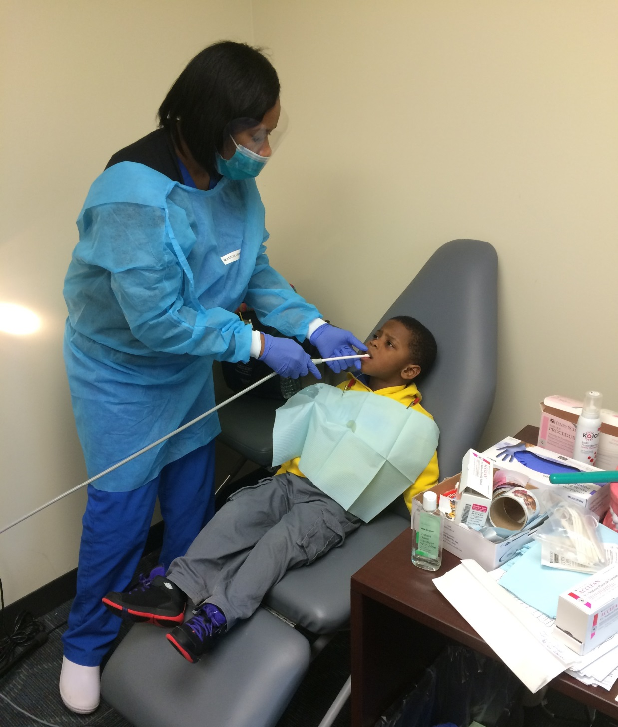
Woodland Academy

Slide 8
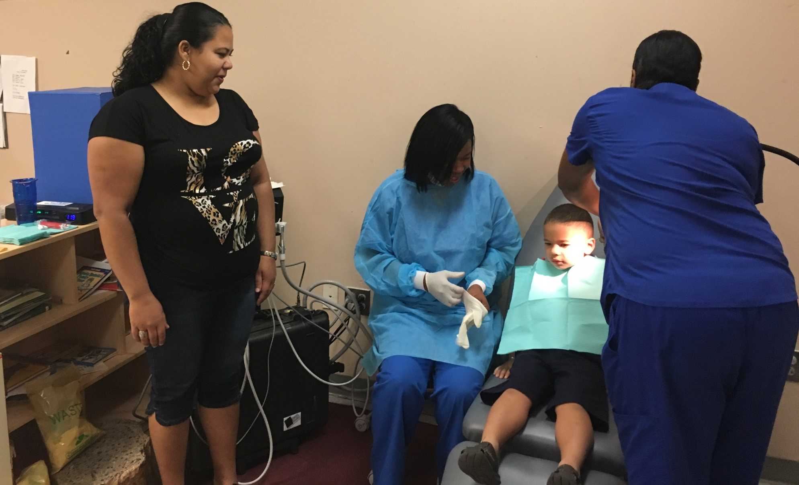
Woodland Academy

Slide 9
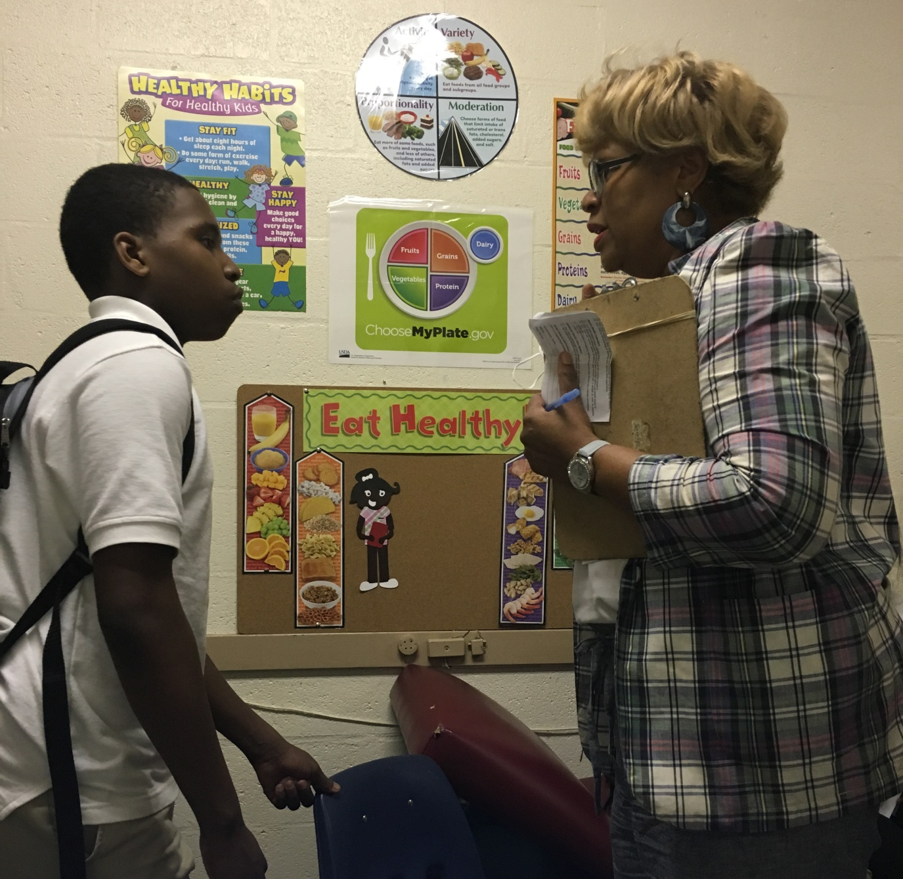
Charter Schools

Slide 10
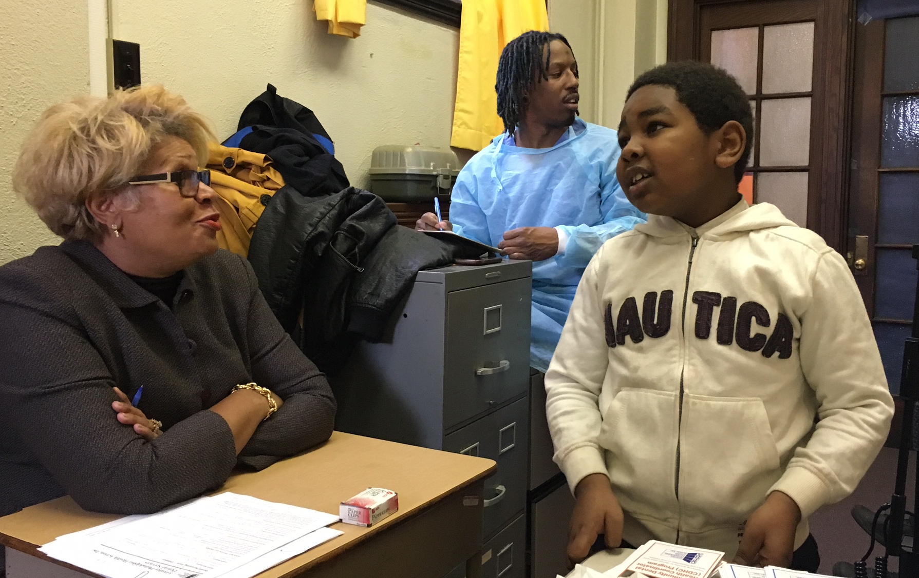
Charter Schools

Slide 11
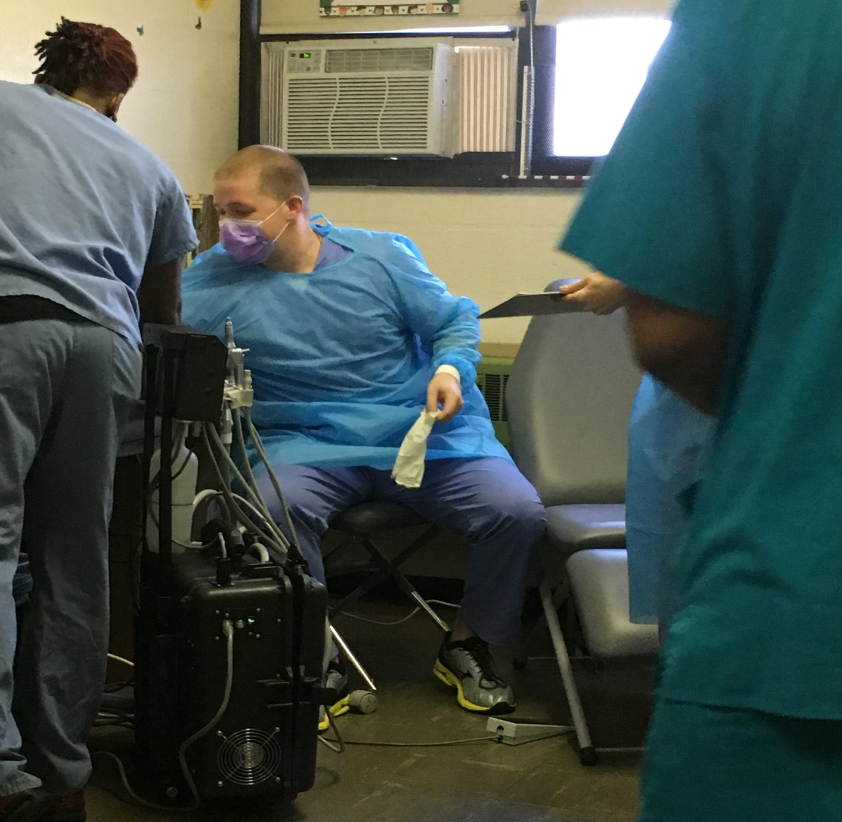
Temple Extern at
Charter Schools

Slide 12
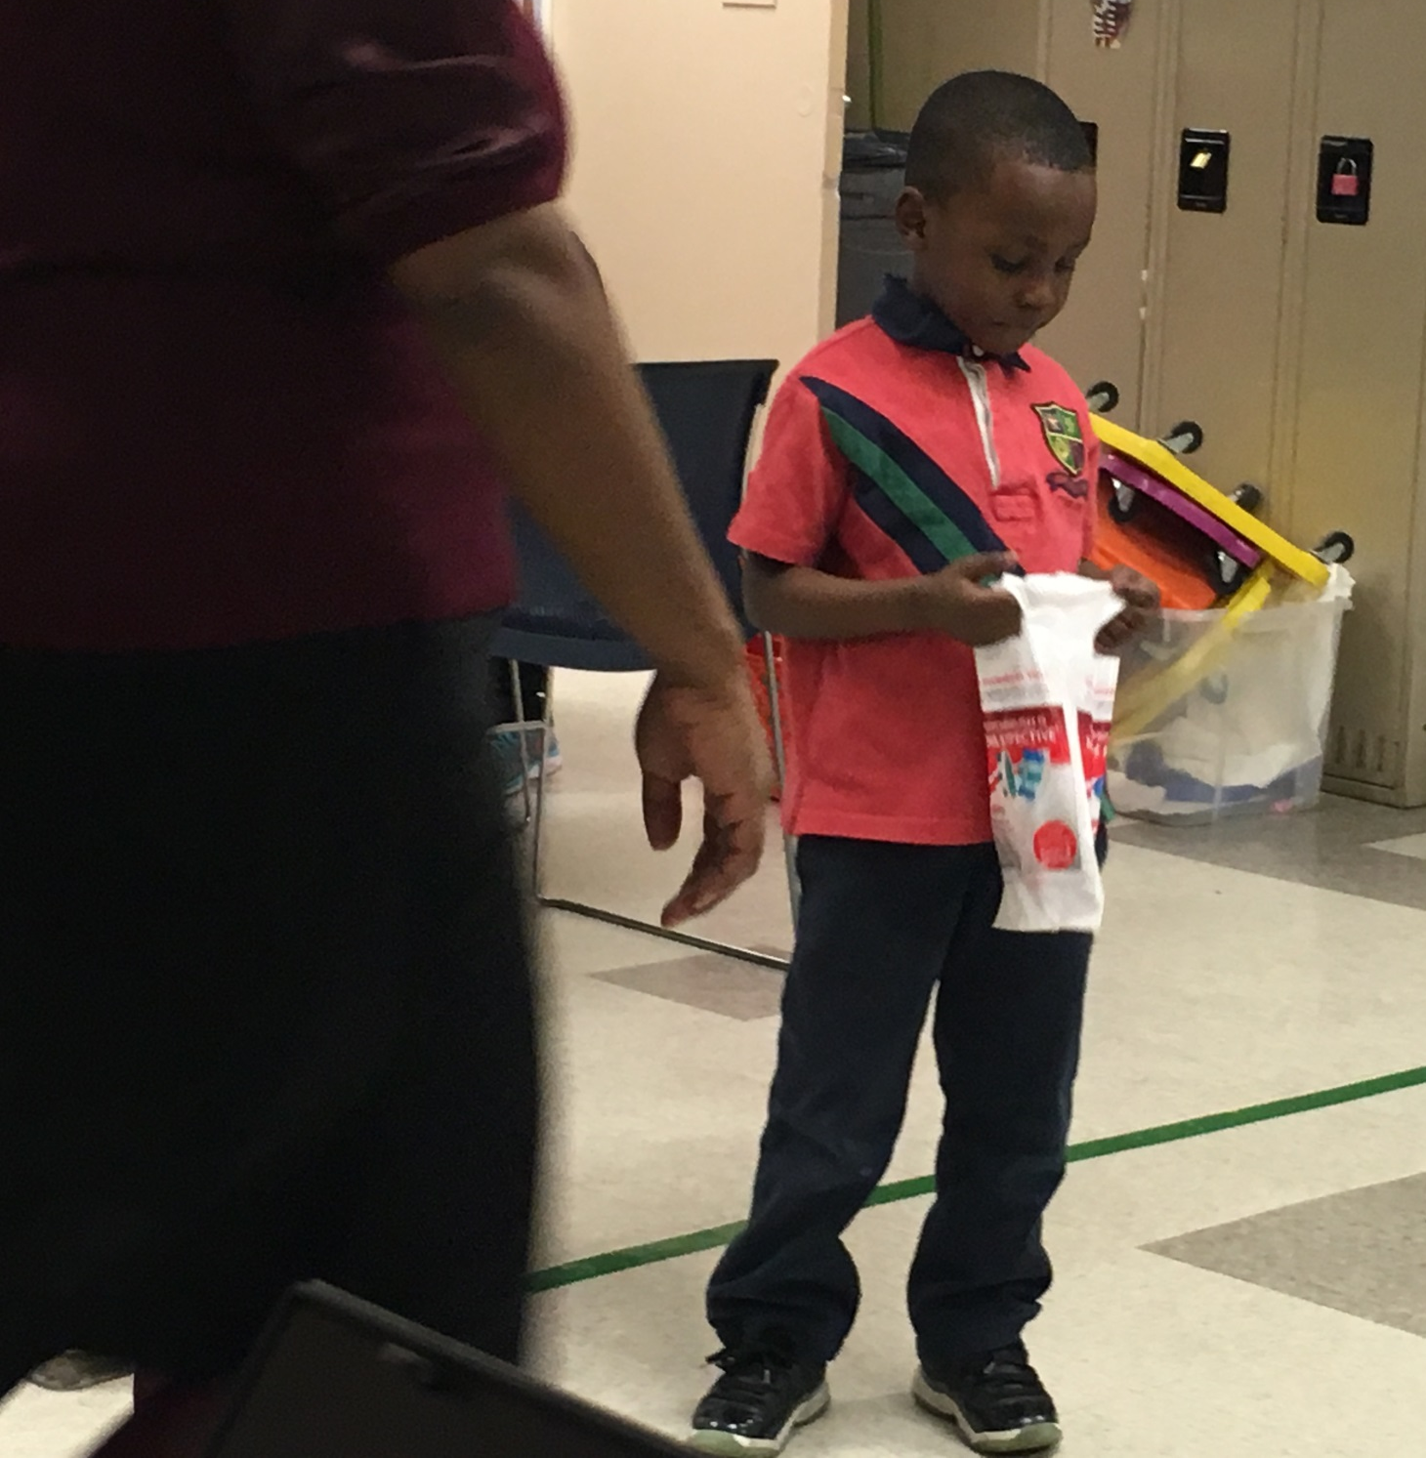
Head
Start

Slide 13
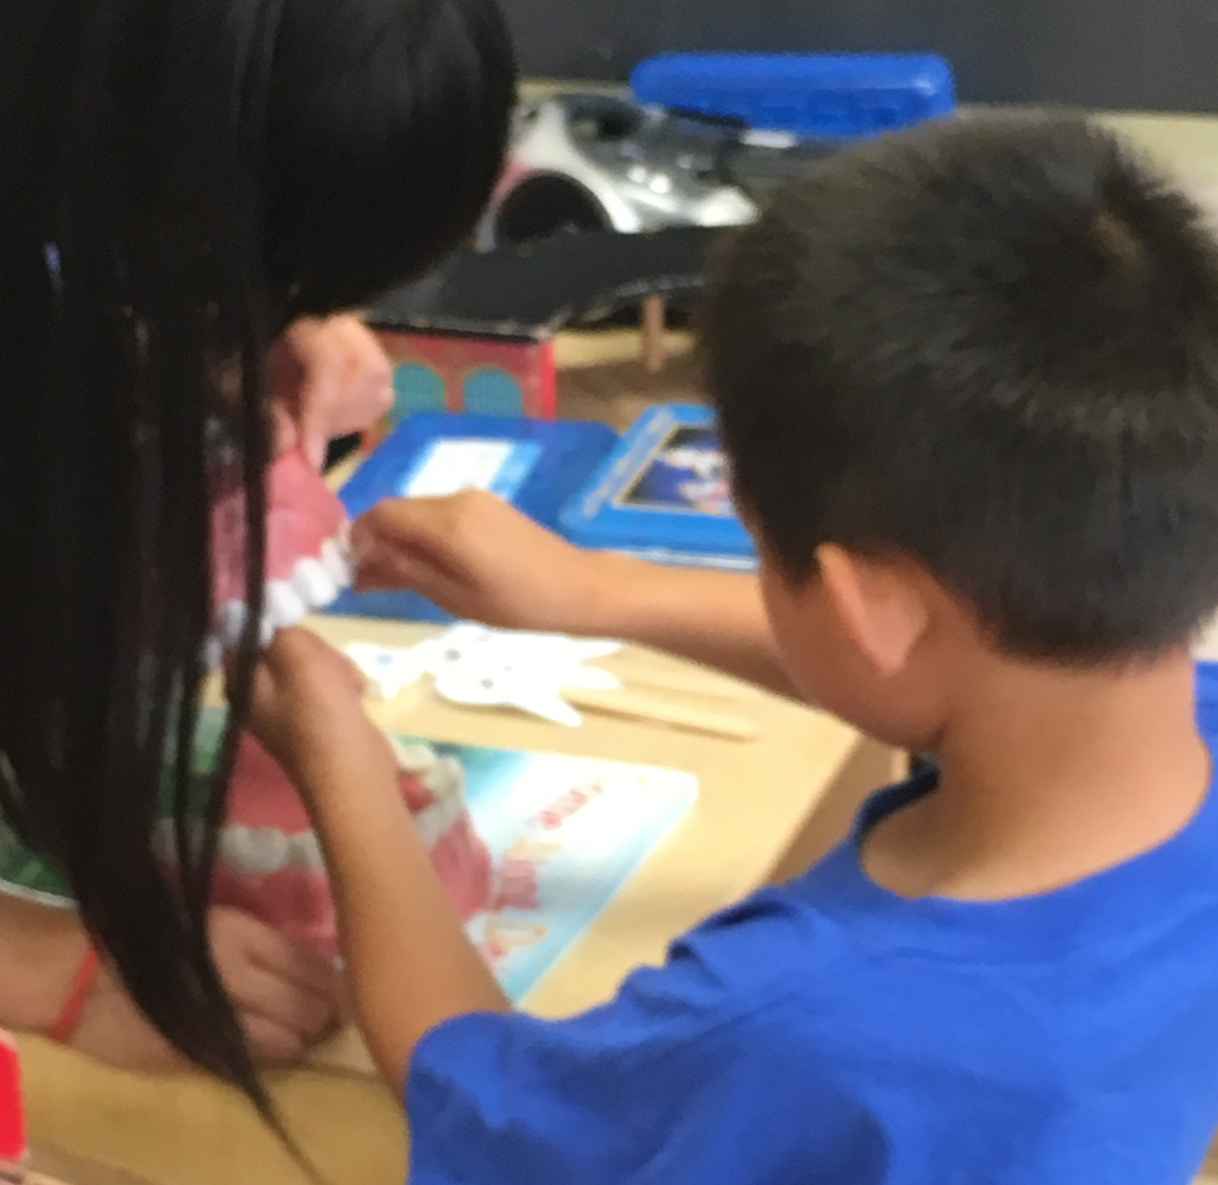
Day
Care

Slide 14
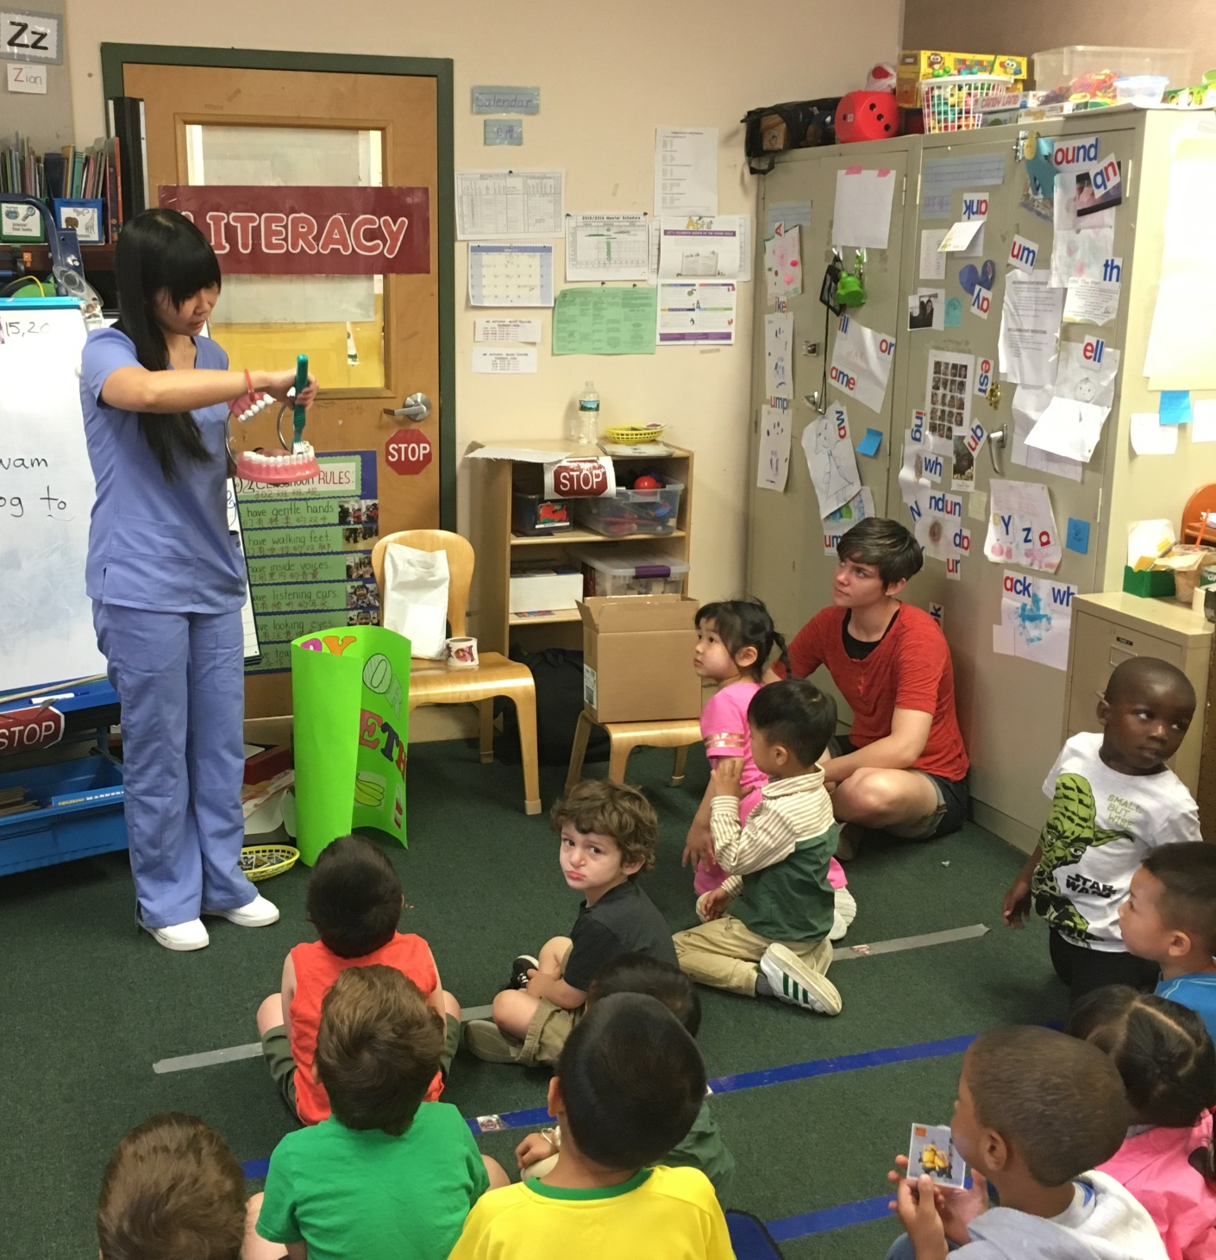
Day
Care

Slide 15
Day
Care

Slide 16
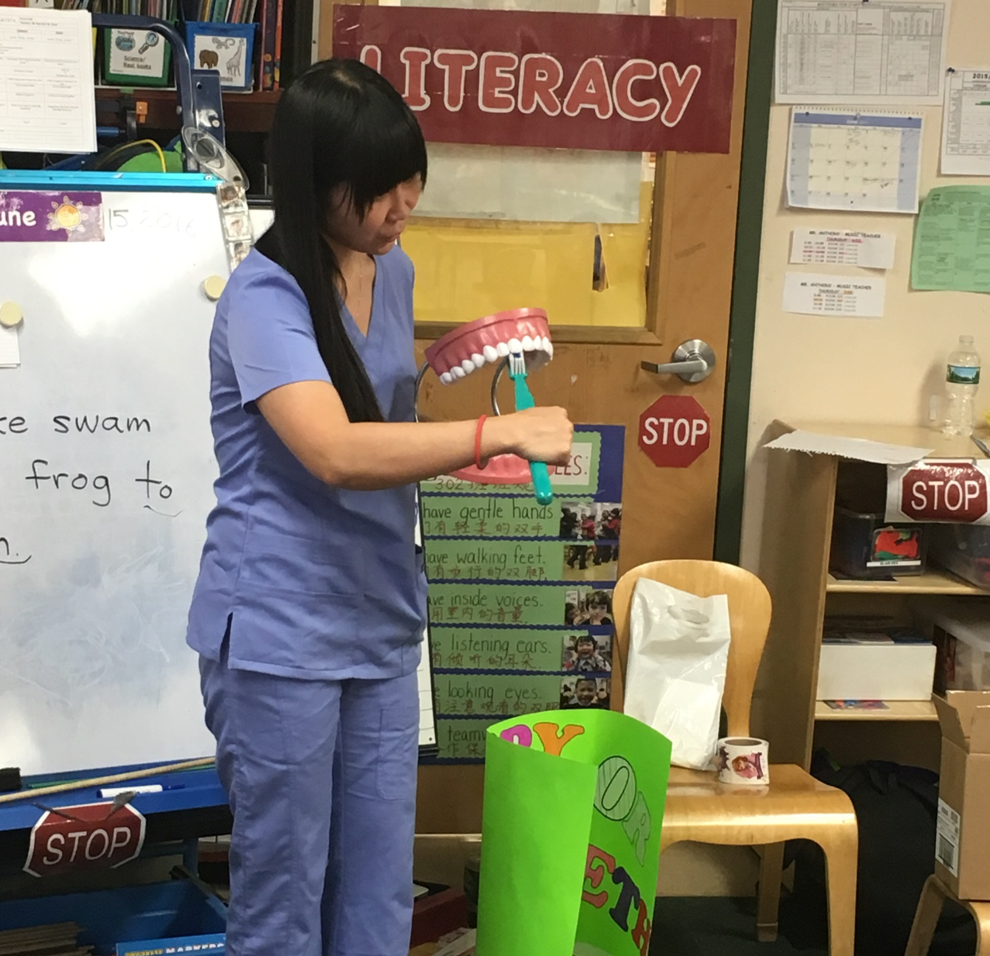
Day
Care

Slide 17
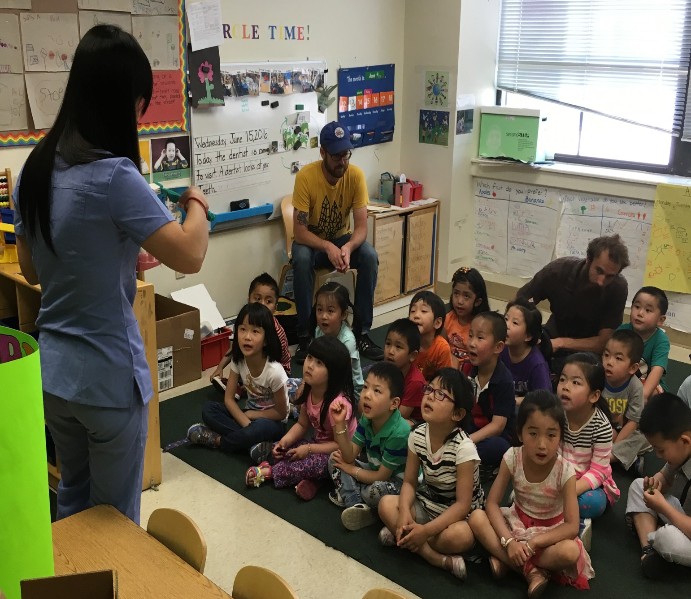
Day
Care

Slide 18
Social Service Agencies
Boys and Girls Clubs
Wissahickon
Shane Victorino
Club Senior Centers
Community Centers
MCO-sponsored “Baby Showers”

Slide 19
Boys
And
Girls
Clubs

Slide 20
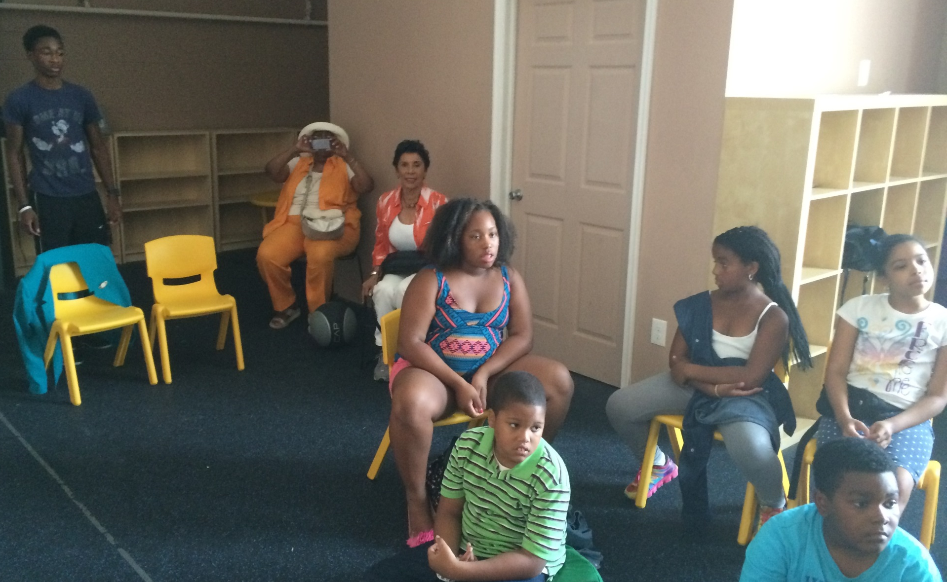
Boys
and
Girls Clubs

Slide 21
Business and Industry
Colgate Bright Smiles – Bright Futures
MCOs
Block Scheduling for Health Partners (HPP) patients
Saturday events for HPP and Keystone First (KF)

Slide 22
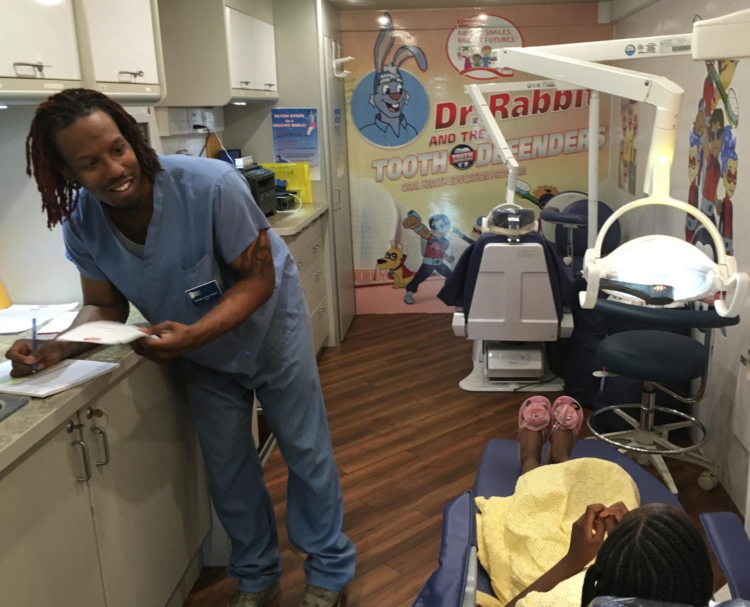
Colgate
Bright Smiles
Bright
Futures

Slide 23
Medical Healthcare Facilities
Operating Room
Treat Pediatric patients under GA
Treat patients with disabilities under GA
GPHA Medical/Dental/Behavioral Health Integration
Internal referrals
PQ9 Questionnaire

Slide 24
Churches
Health Fairs
Yesha Ministries
Youth at Risk
Surge Recovery Residential Program
63 men; Transitional population; group size changes
Most need dental evaluation; most are insured
Most have neglected routine oral health care
CDHCs make presentation and provide give-aways
Use portable equipment to conduct screenings
Challenges: Patient Compliance/Relapse Risk
2 visits to date; 15 men have been treated; goal is monthly

Slide 25
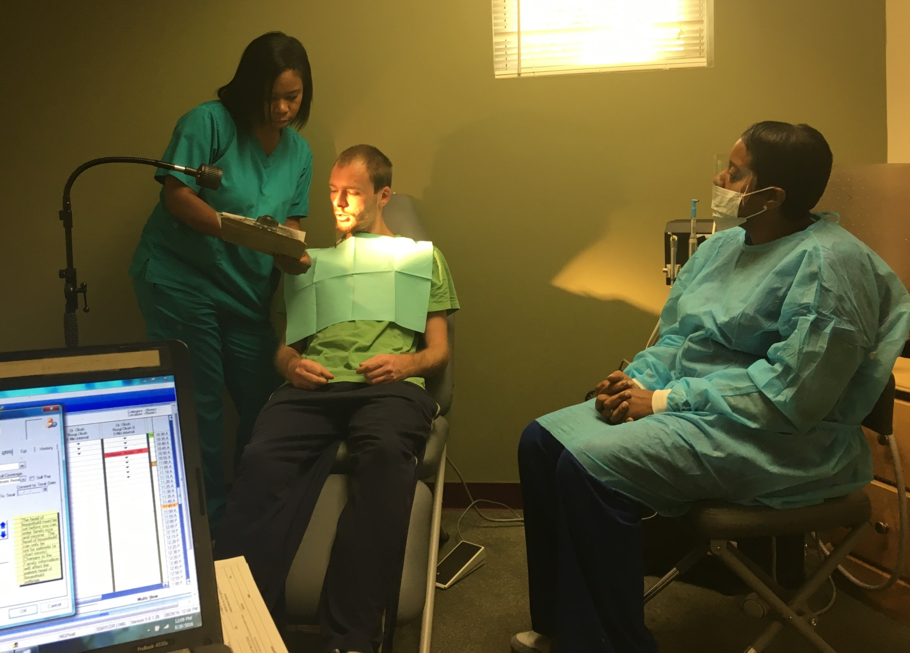
Surge Recovery

Slide 26
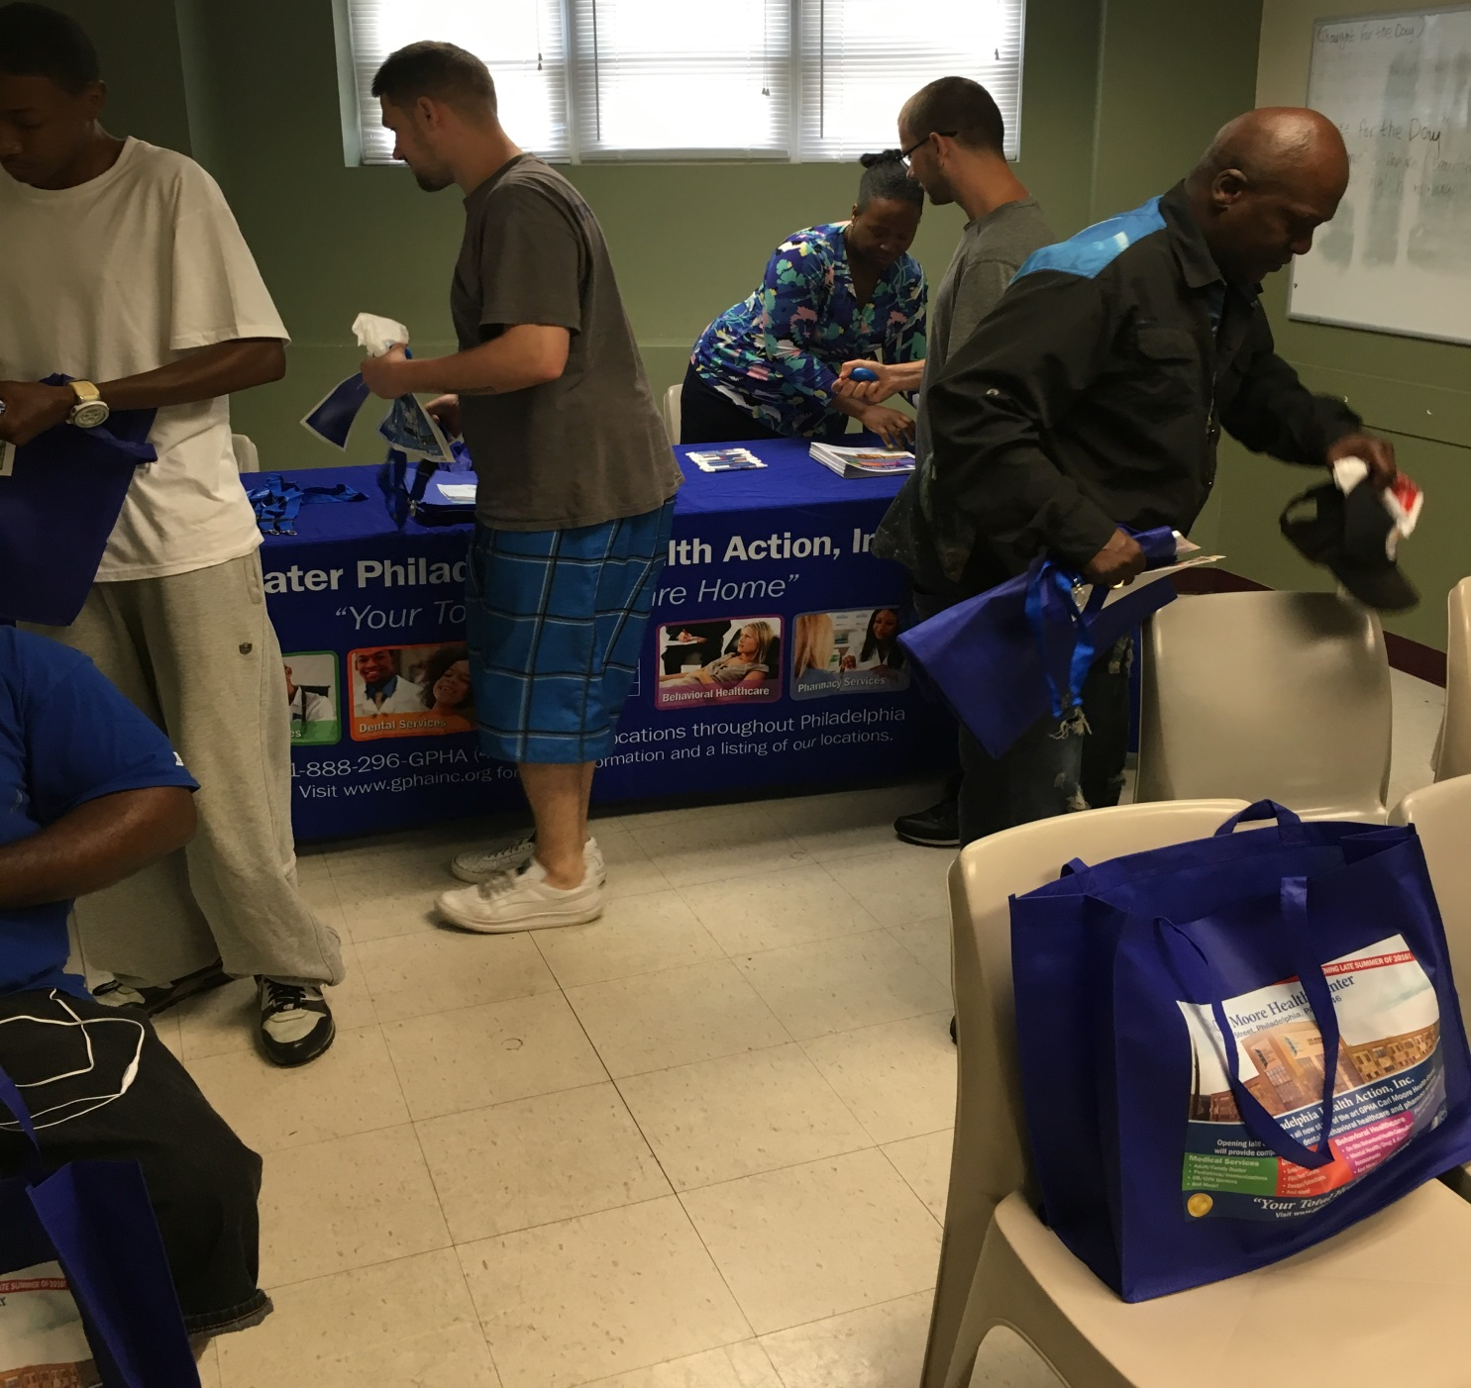
Surge Recovery

Slide 27
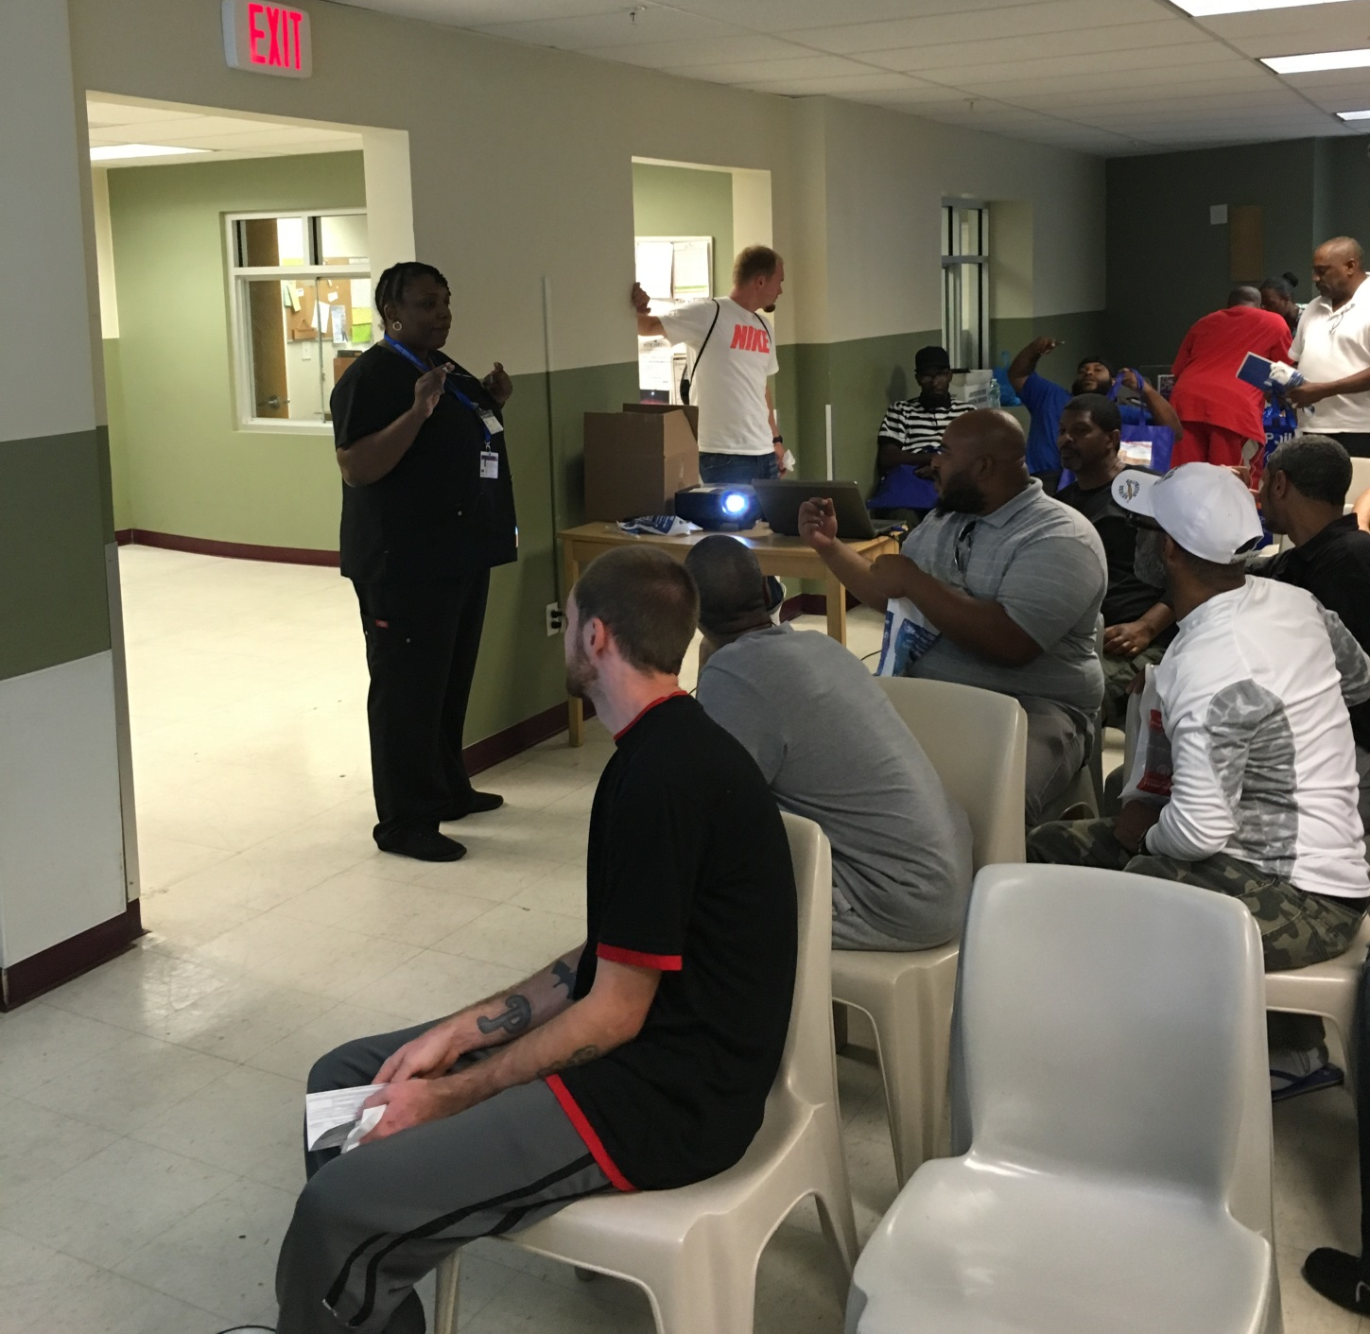
Surge Recovery

Slide 28
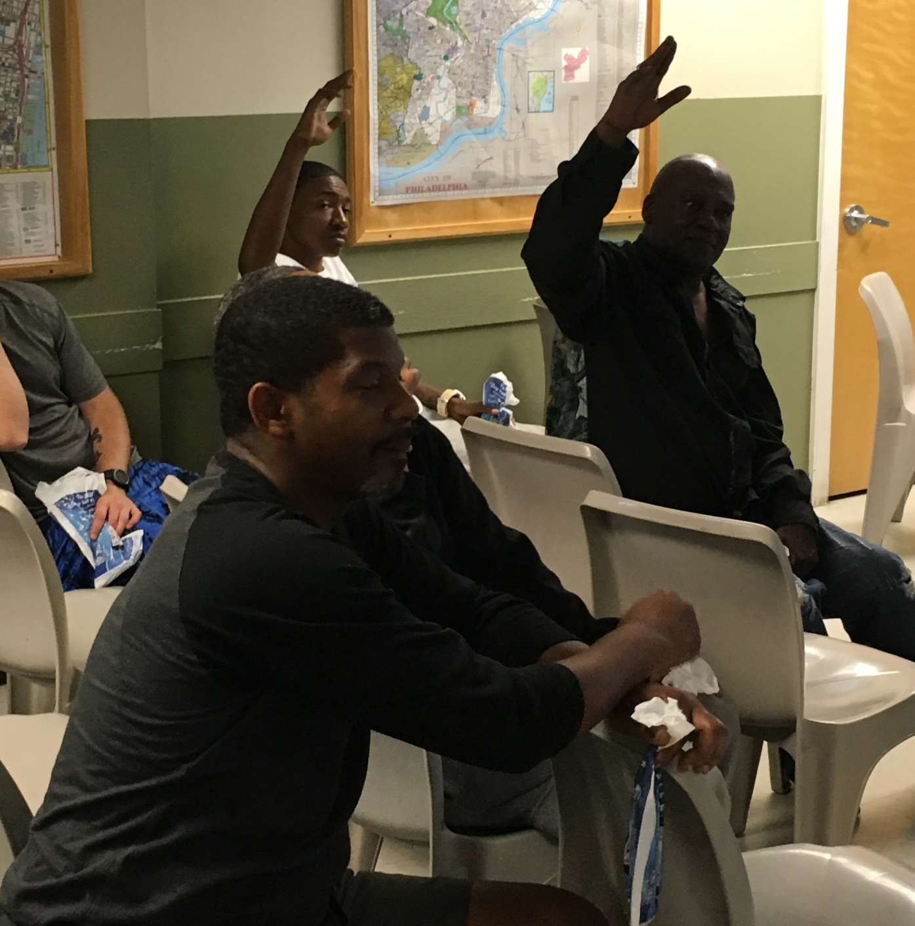
Surge Recovery

Slide 29
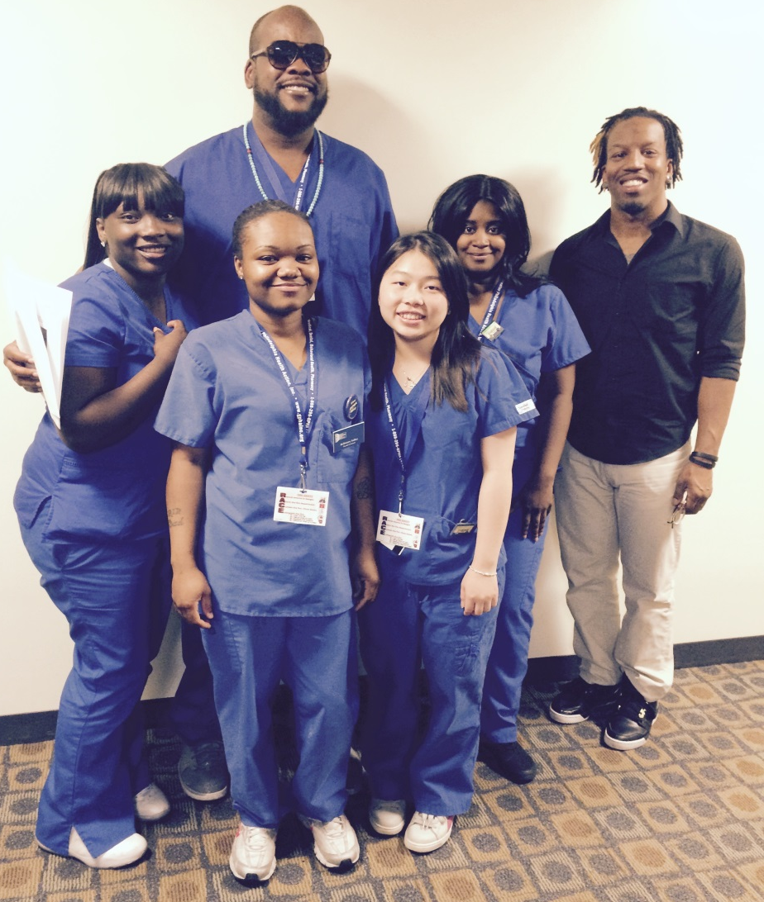
Strengthening People and Empowering the Community through Collaboration Partnerships and Dental Outreach

